Slide 1
0 1 1 0
FORWARD

Slide 2
1 1 1 0
LEFT

Slide 3
0 1 1 0
FORWARD

Slide 4
0 1 1 1
RIGHT

Slide 5
0 1 1 0
FORWARD

Slide 6
0 1 1 1
RIGHT

Slide 7
0 1 1 0
FORWARD

Slide 8
1 1 1 0
LEFT

Slide 9
0 1 1 0
FORWARD

Slide 10
0 0 1 1
RIGHT

Slide 11
0 1 1 0
FORWARD

Slide 12
0 1 1 0
FORWARD

Slide 13
1 1 1 0
LEFT

Slide 14
0 1 1 0
FORWARD

Slide 15
0 1 0 0
LEFT

Slide 16
0 1 1 0
FORWARD

Slide 17
0 0 1 1
RIGHT

Slide 18
0 1 1 0
FORWARD

Slide 19
0 0 1 1
RIGHT

Slide 20
0 0 1 1
RIGHT

Slide 21
0 0 1 0
RIGHT

Slide 22
0 1 1 0
FORWARD

Slide 23
1 1 1 1
STOP

Slide 24
INPUT
Robot Configuration
About Track
Length : 12cm
Width : 3 cm
Width : 5cm
Black Line
Number of Sensors : 4
S->S Distance : 1cm

Slide 25
FORWARD
1 1 1 1
But What if…..
Width : 4 cm
Number of Sensor : 4

Slide 26
FORWARD
0 0 1 1 0 0
OR…
Width : 3 cm
Number of Sensors : 6

Slide 27
Bot specification
S->S Distance:
Number of sensor:
Dimension:
Width:

Slide 28
Track specification
Line Width:
Angles :

Slide 29
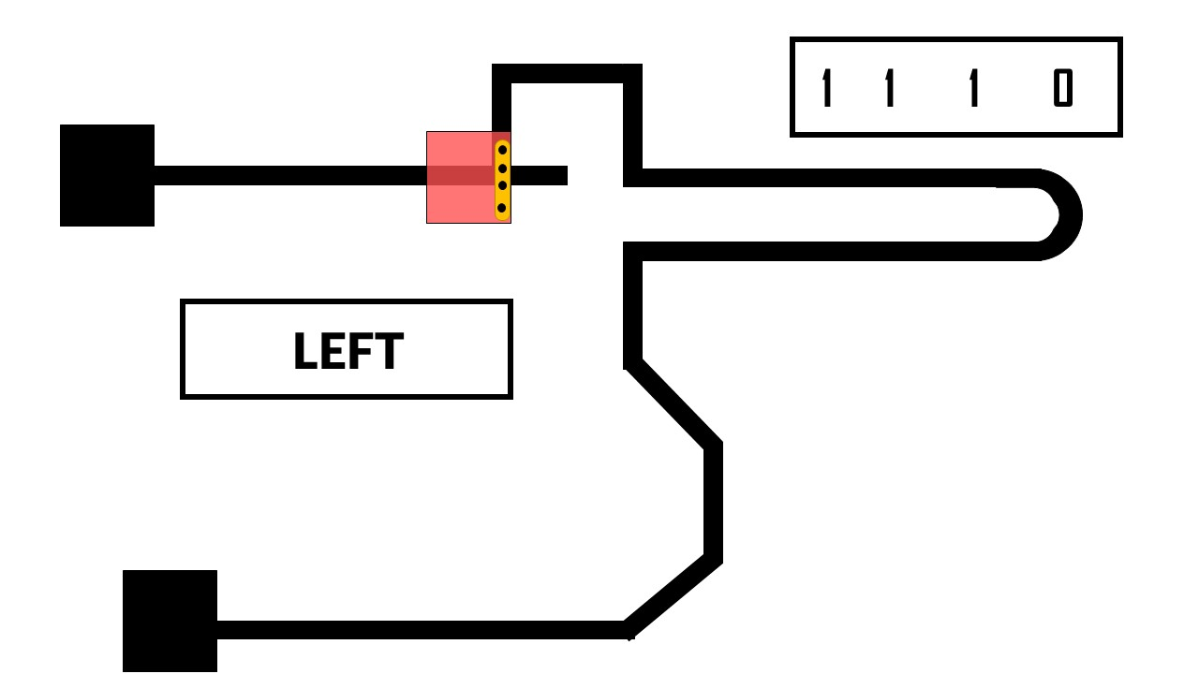
Dynamic LFR Software
120

Slide 30
FORWARD
RIGHT
1 1 1 1
1 1 1 1
1 1 1 1
1 1 1 1
LEFT
STOP
1 1 1 1
1 1 1 1
1 1 1 1
1 1 1 1

